Slide 1

Social Network Analysis: Basic Concepts
Sean P. Goggins, Ph.D
Associate Professor, University of Missouri
Based on:
Scott, J. (2012). Social network analysis. Sage.

Slide 2

Networks and Relations
Centrality and Power: Closeness, betweenness and other measures of centrality and power
Cohesion: Distance and densities (how tight is the network?)
Subgroups: Cliques and zones within a network
Roles and Positions : Where are different people in a particular network?
Subgroups

Slide 3
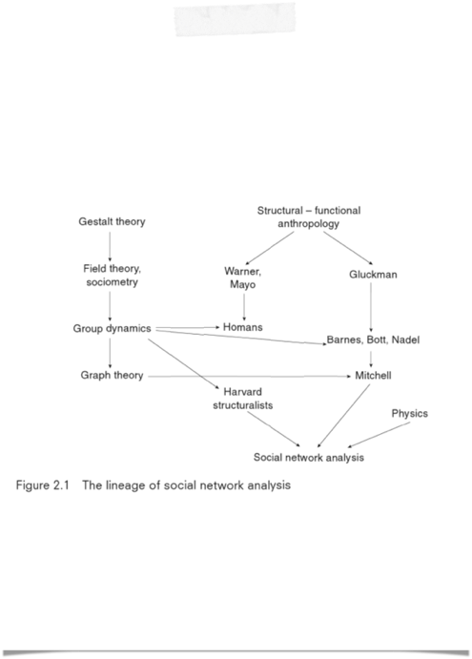
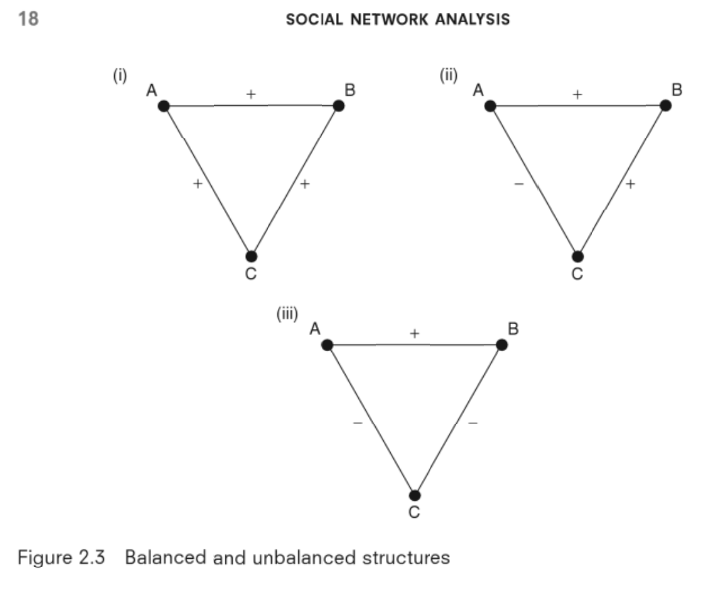

Development of SNA
Image from:
Scott, J. (2012). Social network analysis. Sage.
Image from:
Scott, J. (2012). Social network analysis. Sage.
A lot can be learned by thinking about Triads
“Never underestimate the power of a small group of committed citizens to change the world. Indeed, it is the only thing that ever has” — Margaret Mead

Slide 4
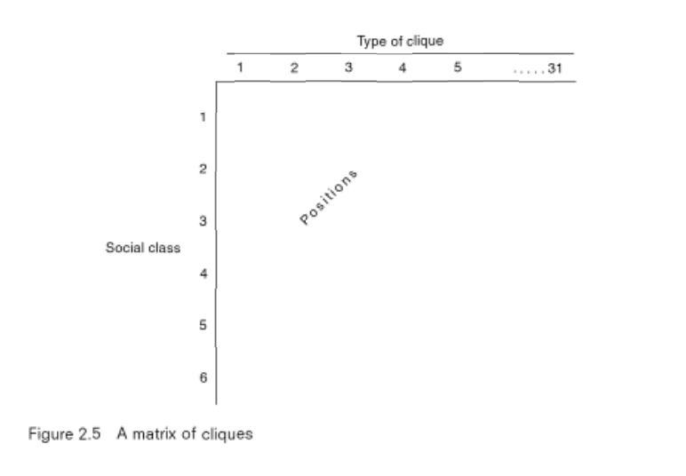
Development of SNA
Homophily
People cluster with people like themselves offline
People cluster with people like themselves ONLINE; but the definition of “like” (similarity) is more malleable and sensitive to context
Image from:
Scott, J. (2012). Social network analysis. Sage.
A lot can be learned by thinking about Triads

Slide 5
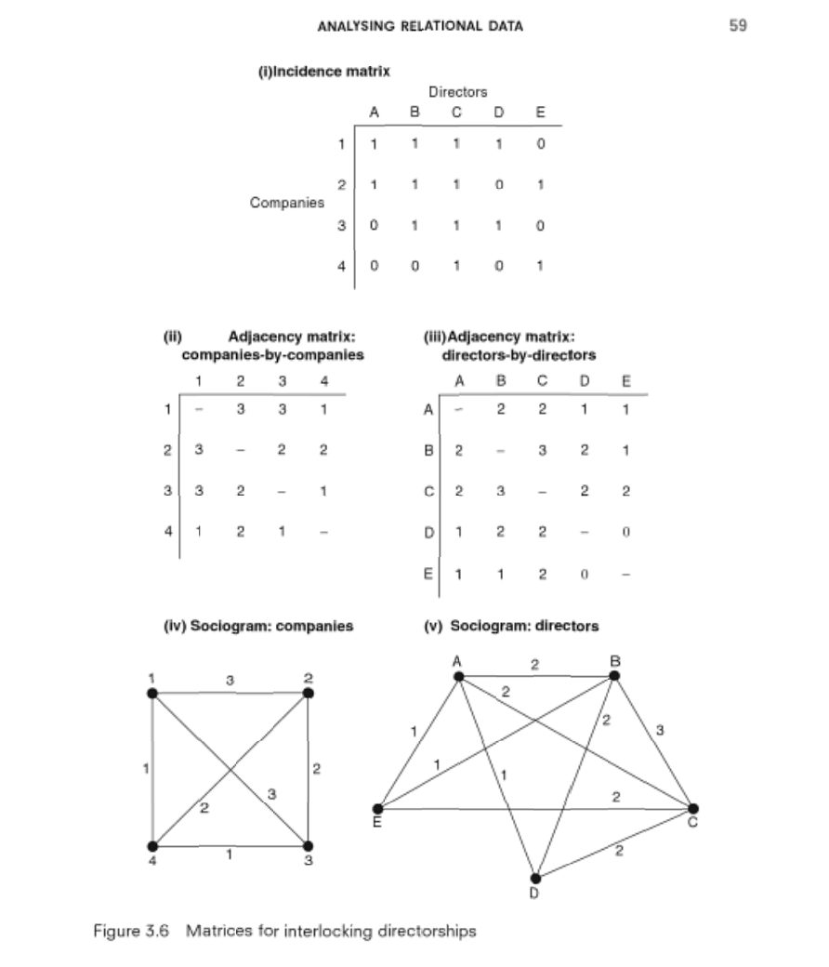
Analyzing Relational Data
This is a conceptual representation of “interlocking directorates”
Companies
People
People - People
Companies - Companies
People - Companies
Image from:
Scott, J. (2012). Social network analysis. Sage.

Slide 6
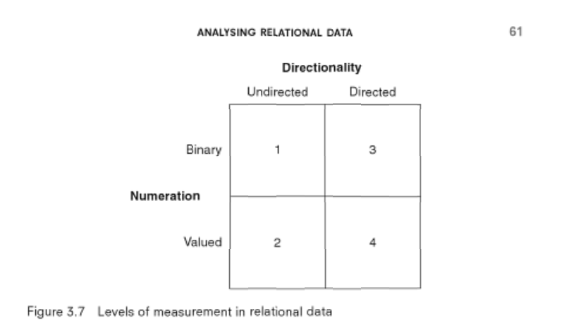
Analyzing Relational Data
Directionality (in degree / out degree)
Numeration (weight)
Unlike lecture this morning, in social network analysis of online interactions, we are weighting discrete interactions, not “number of friends”
Image from:
Scott, J. (2012). Social network analysis. Sage.

Slide 7
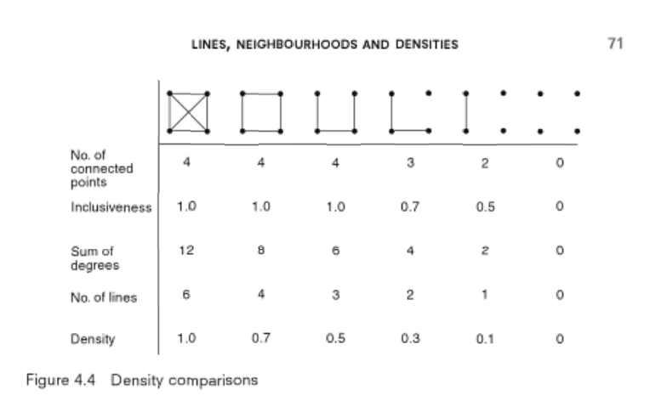
Lines, Neighborhoods & Densities
Look closely at this simple example to begin to understand how density is compared. Notice the relationship between density, a network level measure, and degree, an individual level measure
Image from:
Scott, J. (2012). Social network analysis. Sage.

Slide 8
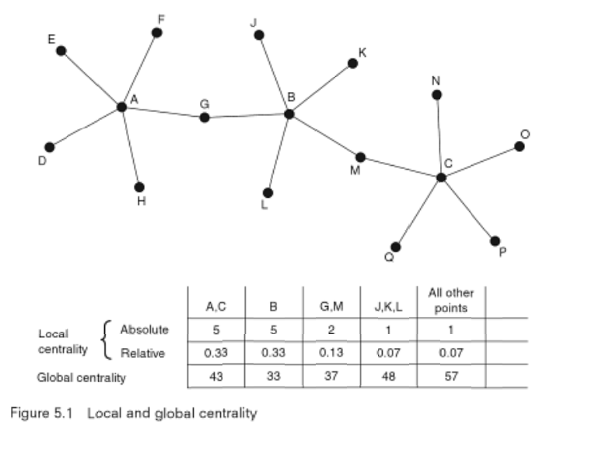
Centrality, Peripherality and Centralization
Interconnected networks
Degree based measures, plus the distance one must travel between nodes. (A “Bacon Number”)
Image from:
Scott, J. (2012). Social network analysis. Sage.

Slide 9
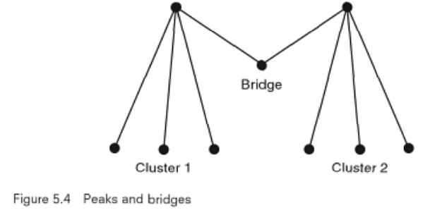
Centrality, Peripherality and Centralization
Betweenness
Brokerage
Bridge
Image from:
Scott, J. (2012). Social network analysis. Sage.

Slide 10
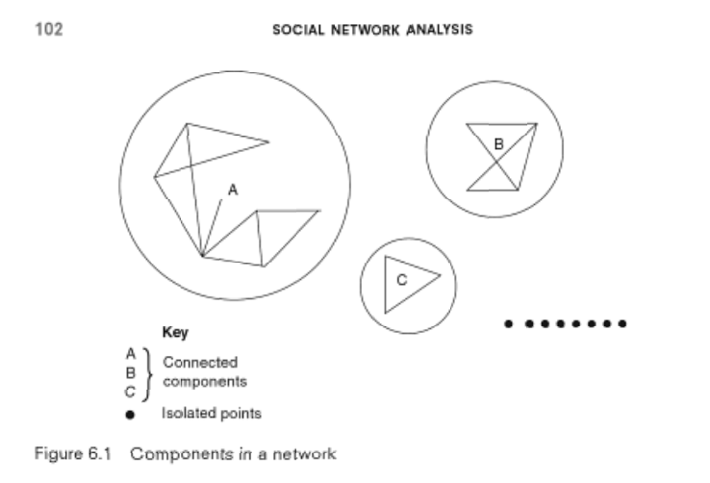
Components, Cores and Cliques
Connected components of a disconnected set of networks
Isolates
Image from:
Scott, J. (2012). Social network analysis. Sage.

Slide 11
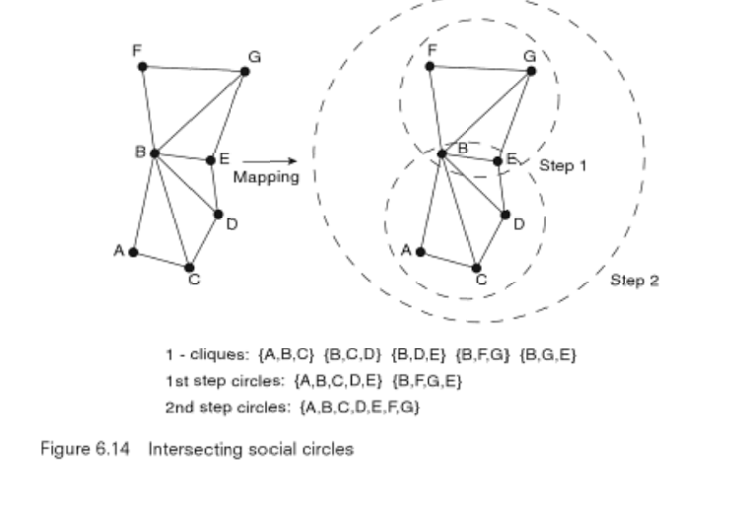
Components, Cores and Cliques
Intersecting social circles
Image from:
Scott, J. (2012). Social network analysis. Sage.

Slide 12
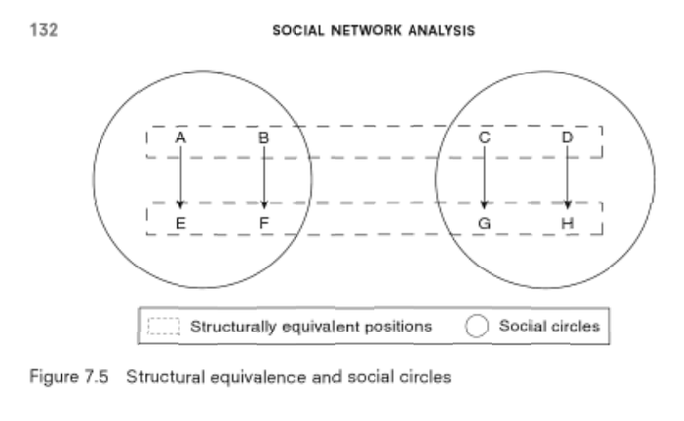
Positions, Sets and Clusters
Structural equivalence
Image from:
Scott, J. (2012). Social network analysis. Sage.

Slide 13
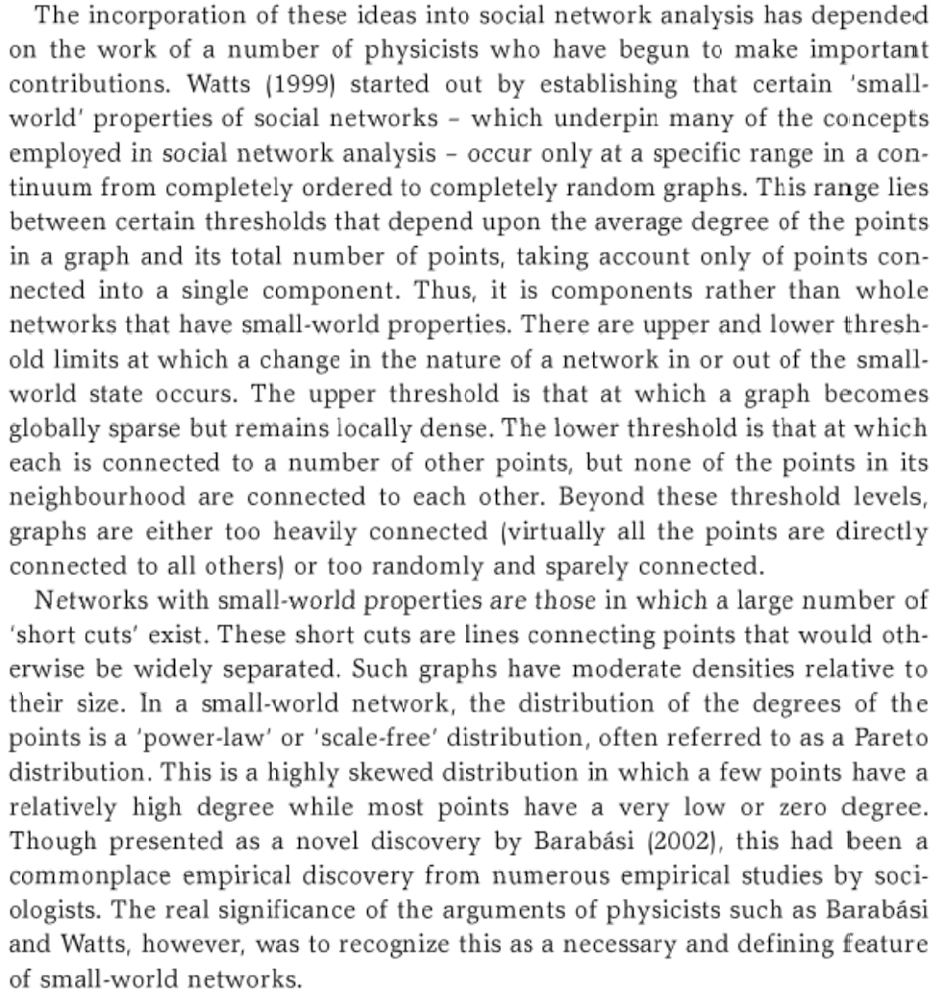
Network Dynamics and Change over Time
Quotation from:
Scott, J. (2012). Social network analysis. Sage.

